Slide 1
INTERN CAREER DEVOPS INTERNSHIP

Slide 2
CONTENTS
Introduction
System Requirements
EC2 Instances
Setup Jenkins
Acess Jenkins
Configure Version Control
Create Jenkins Pipeline
Configure Docker
Integrate Jenkins with GitHub/GitLab
Testing and Validation
Conclusion
Resources and References

Slide 3
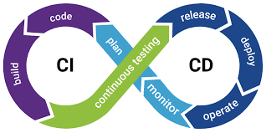
INTRODUCTION
Create a CI/CD pipeline to automate the build, test, and deployment processes for a web application using Jenkins, Docker, and GitHub/GitLab

Slide 4
System Requirements
Launch an EC2 Instance
Login to AWS Console
Navigate to EC2.
Click "Launch Instance."
Choose the "t2.micro" instance type.
Configure other settings (VPC, security groups, key pair, etc.).
Security groups Port - 8080 for Jenkins , Port - 8090 for Docker
Launch the instance.

Slide 5
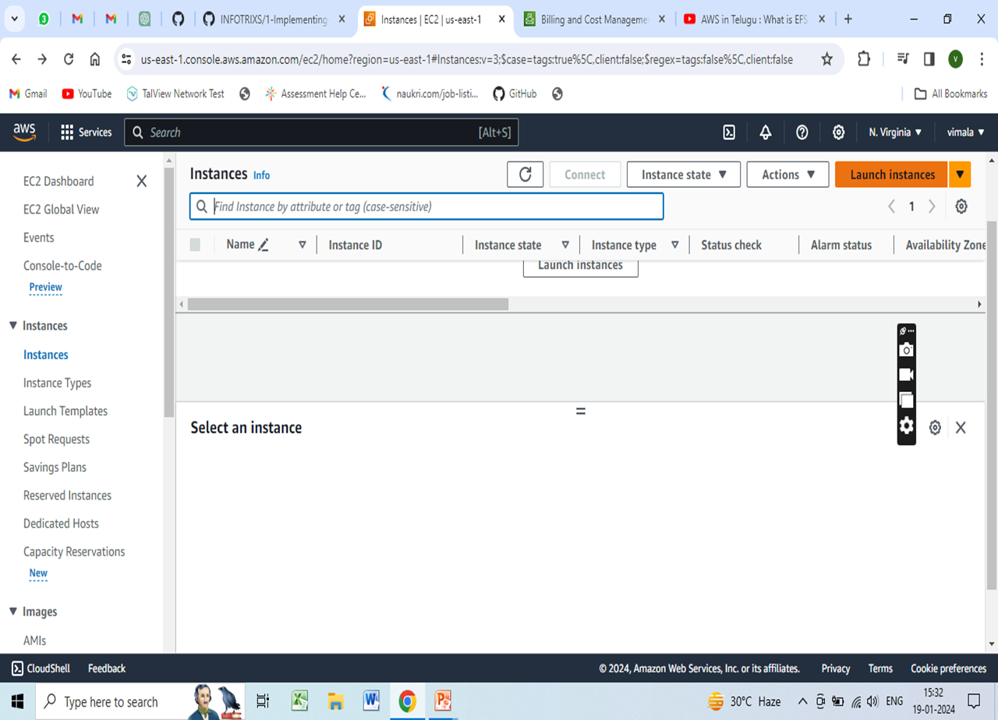
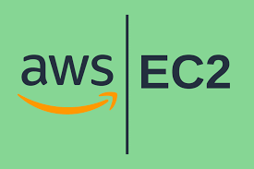
Creating an Amazon EC2 instance

Slide 6
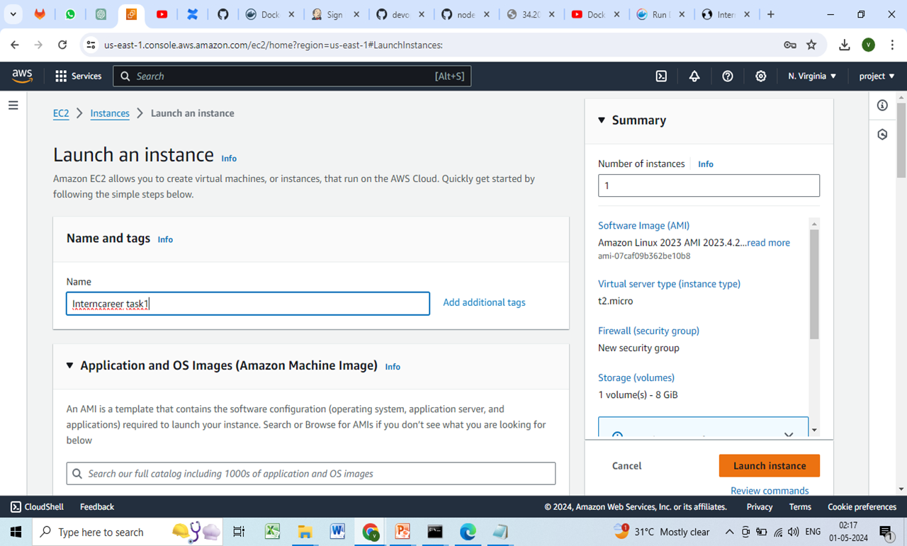

Slide 7
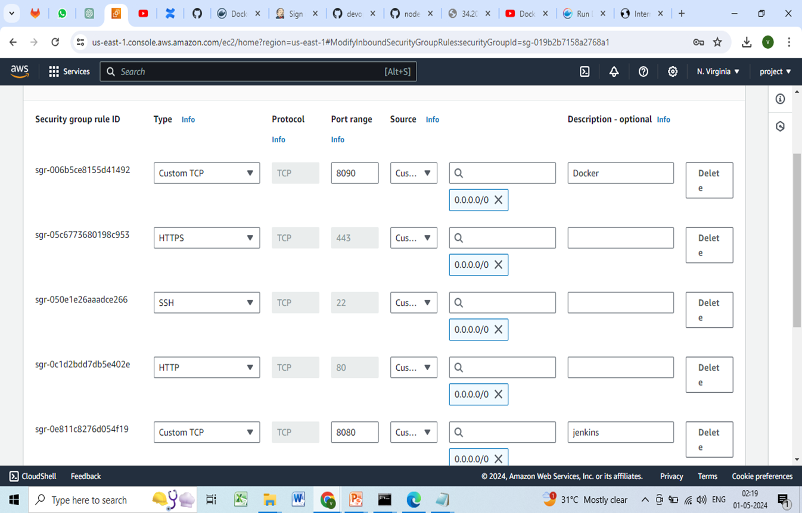
Security group

Slide 8

2. Setup Jenkins:
JENKINS:-
Jenkins is a self-contained, open source automation server which can be used to automate all sorts of tasks related to building, testing, and delivering or deploying software.
Jenkins can be installed through native system packages, Docker, or even run standalone by any machine with a Java Runtime Environment (JRE) installed.

Slide 9
In Continuous Integration after a code commit, the software is built and tested immediately.
In a large project with many developers, commits are made manytimes during a day.
With each commit code is built and tested.
If the test is passed, build is tested for deployment.
If deployment is a success, the code is pushed to production.
This commit, build, test, and deploy is a continuous process and hence the name continuous integration or deployment.

Slide 10
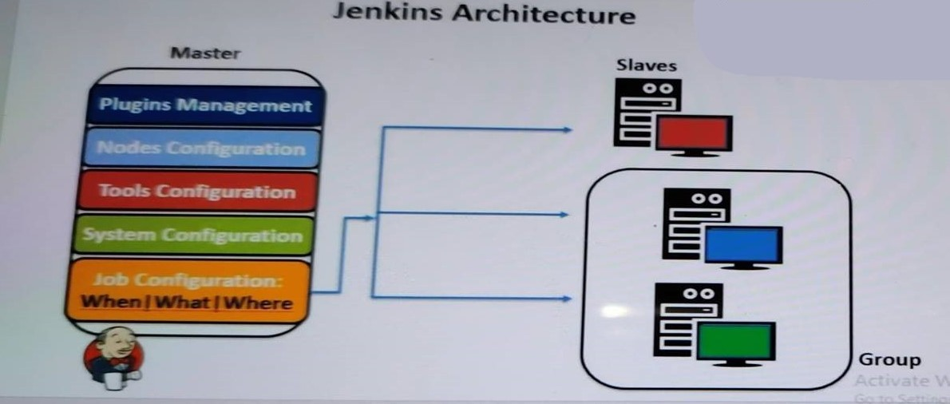
Jenkins Architecture

Slide 11
JENKINS INSTALLATION
a. Install Jenkins on a cloud server (AWS).
Install JDK 8
$ sudo apt update
$ sudo install openjdk-8-jdk -y
Install JDK11 on BuildMachine:
$ apt install openjdk-11-jdk -y

Slide 12
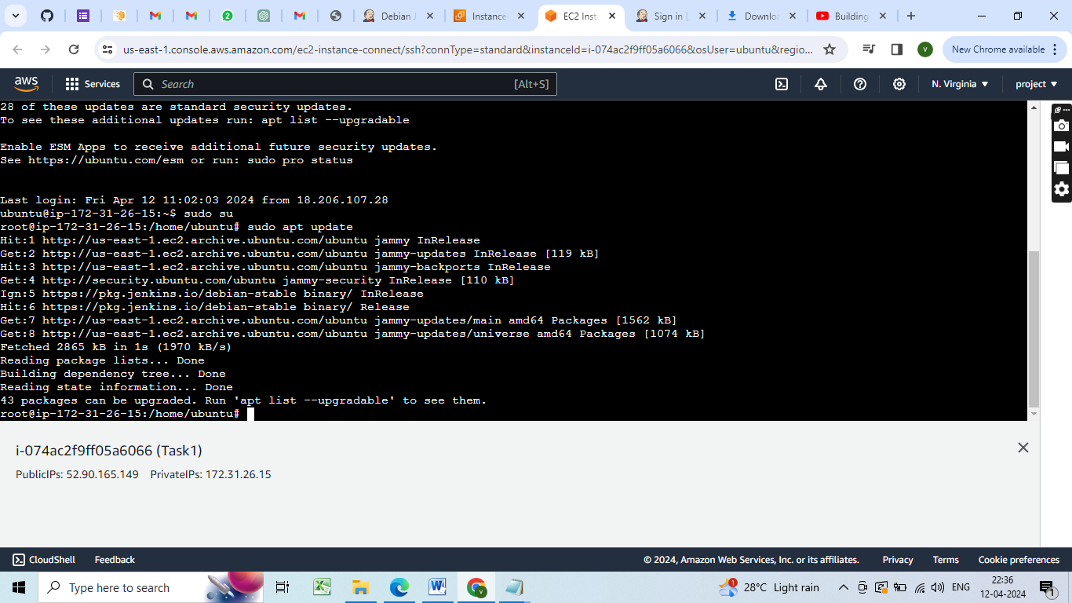
Sudo apt update

Slide 13
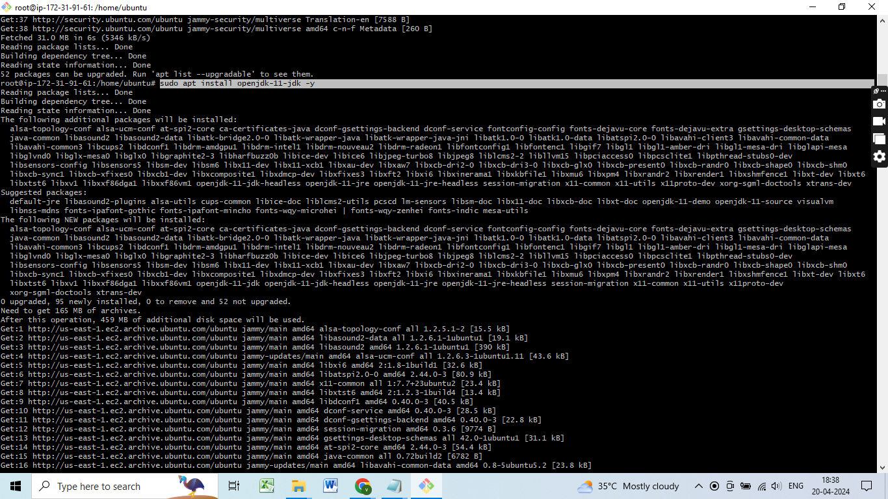
Installing JDK

Slide 14
Add the repository key to the system:
$ sudo wget -O /usr/share/keyrings/jenkins-keyring.asc
https://pkg.jenkins.io/debian-stable/jenkins.io-2023.key

Slide 15
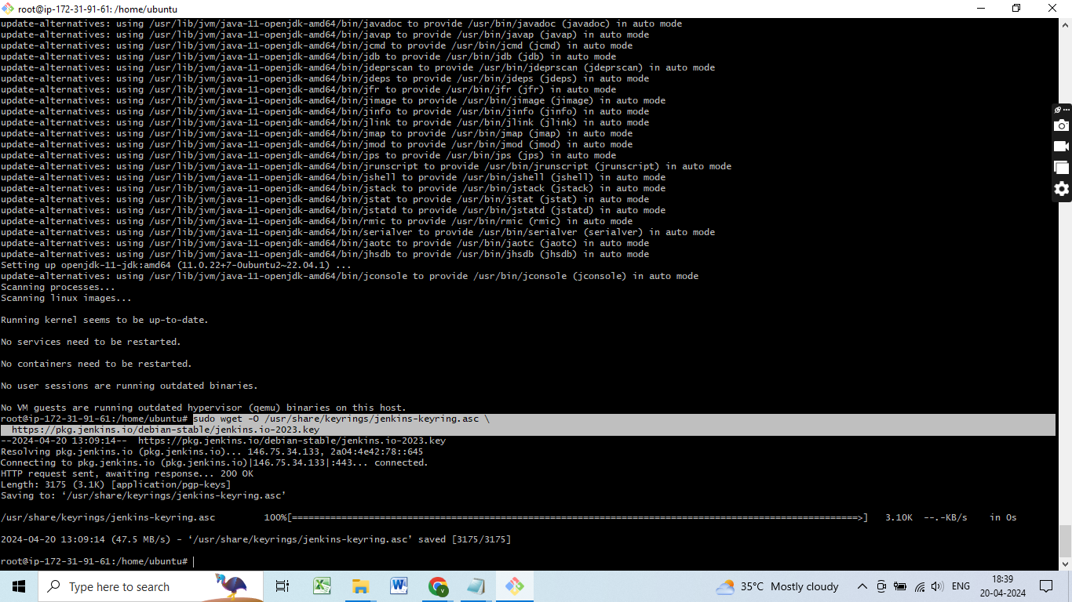
Add the repository key to the system

Slide 16
Append the Debian package repository:
echo deb [signed-by=/usr/share/keyrings/jenkins- keyring.asc]
https://pkg.jenkins.io/debian-stable binary/ | sudo tee/
etc/apt/sources.list.d/jenkins.list > /dev/null

Slide 17
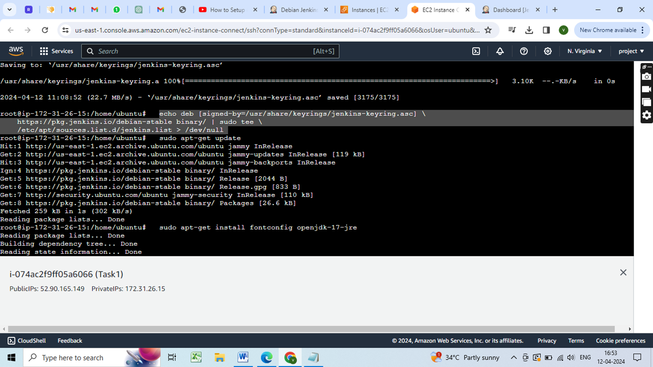
echo deb [signed-by=/usr/share/keyrings/jenkins-keyring.asc] https://pkg.jenkins.io/debian-stable binary/ | sudo tee/ etc/apt/sources.list.d/jenkins.list > /dev/null

Slide 18
Install Jenkins Package
$ sudo apt-get update
$ sudo apt-get install fontconfig openjdk-17-jre
$ sudo apt-get install jenkins

Slide 19
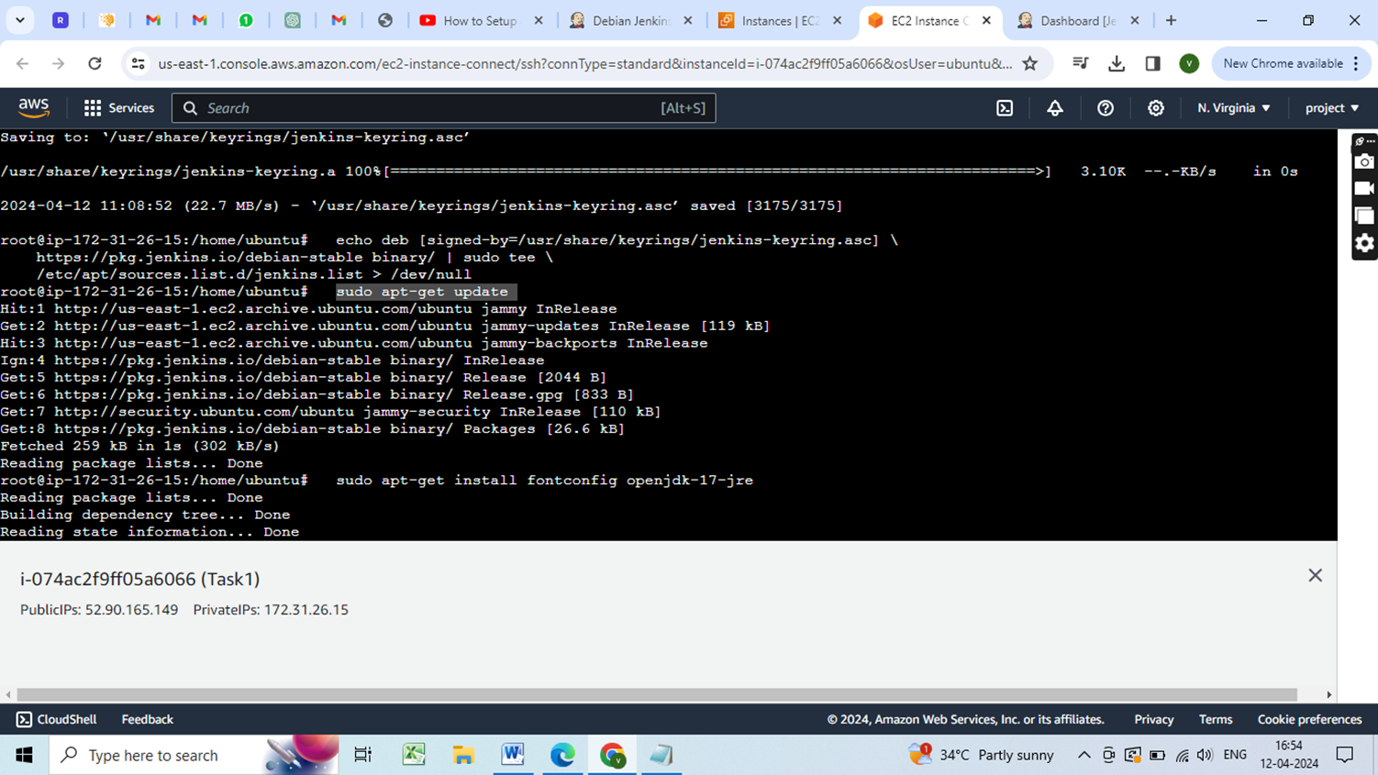
Sudo apt get update

Slide 20
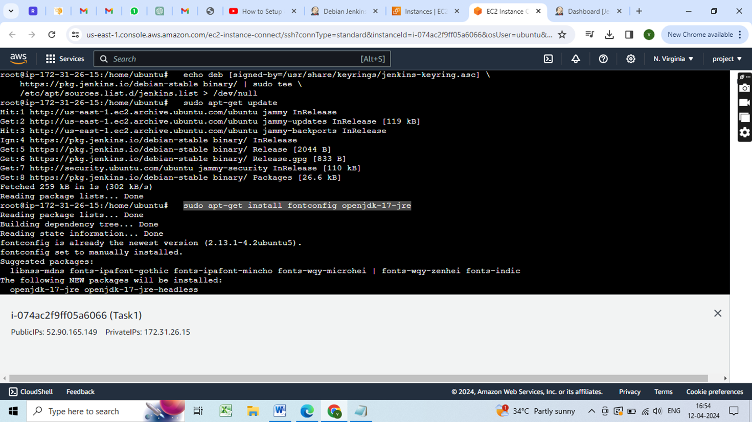
Sudo apt get install jdk17

Slide 21
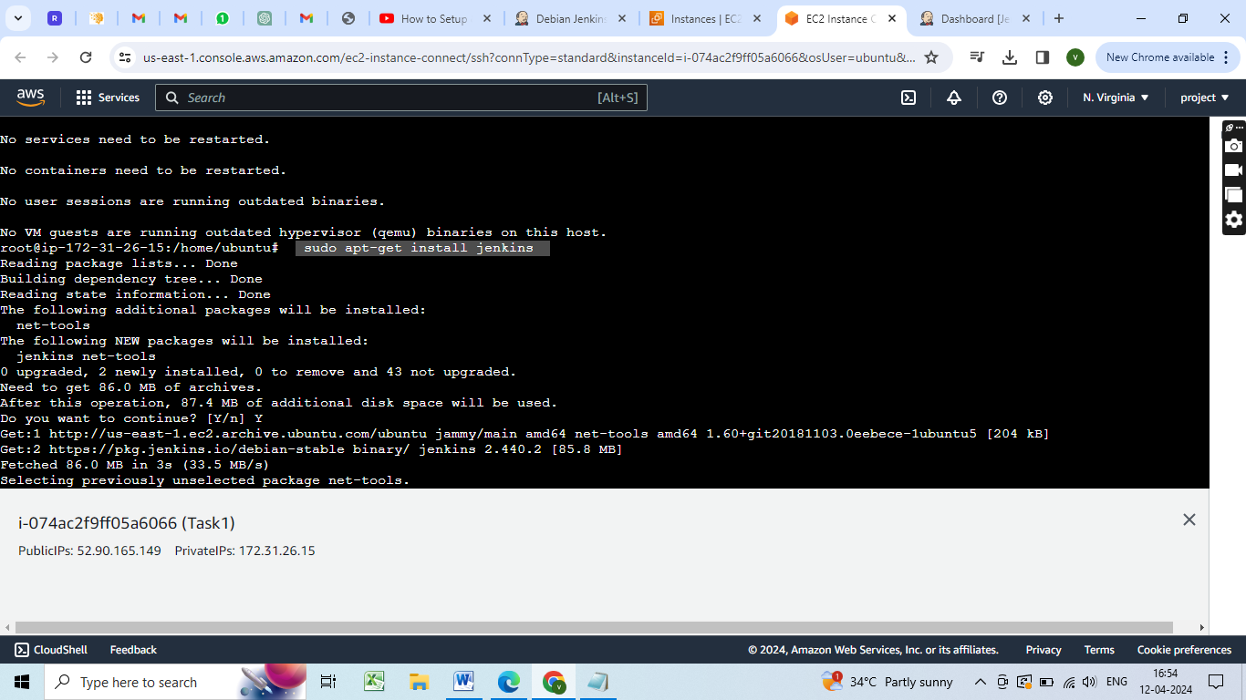
Install jenkins

Slide 22
Status of Jenkins
$ systemctl status jenkins | systemctl start jenkins
systemctl enable jenkins

Slide 23
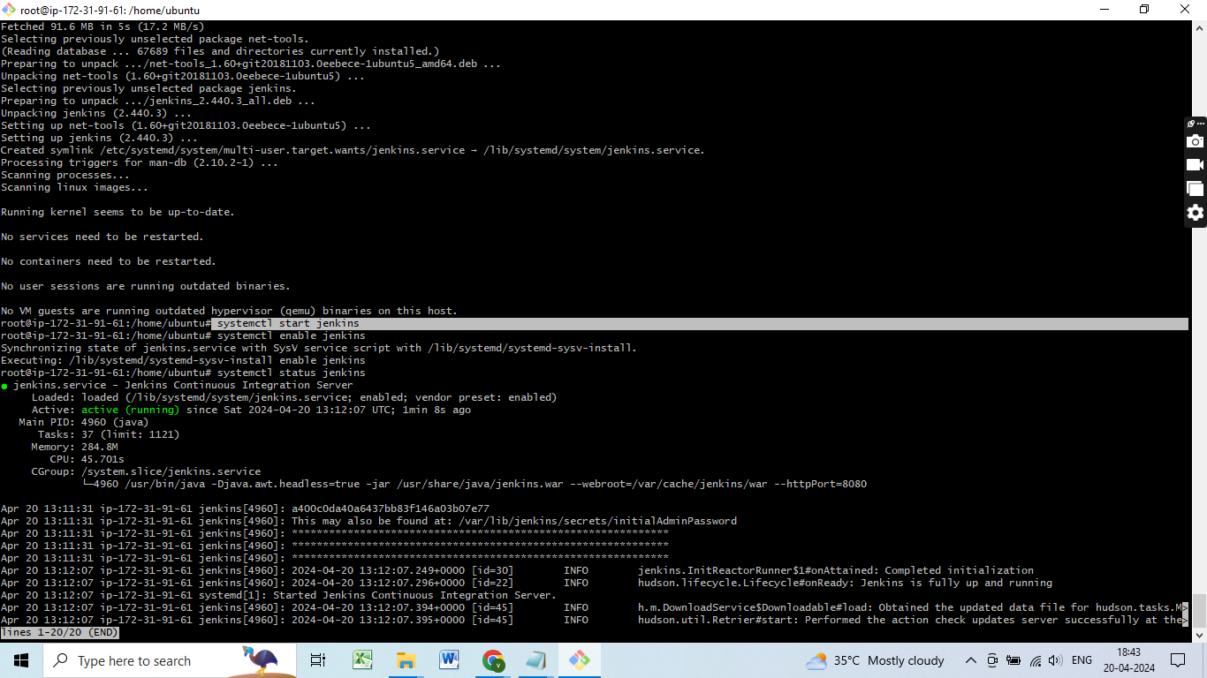
Start jenkins

Slide 24
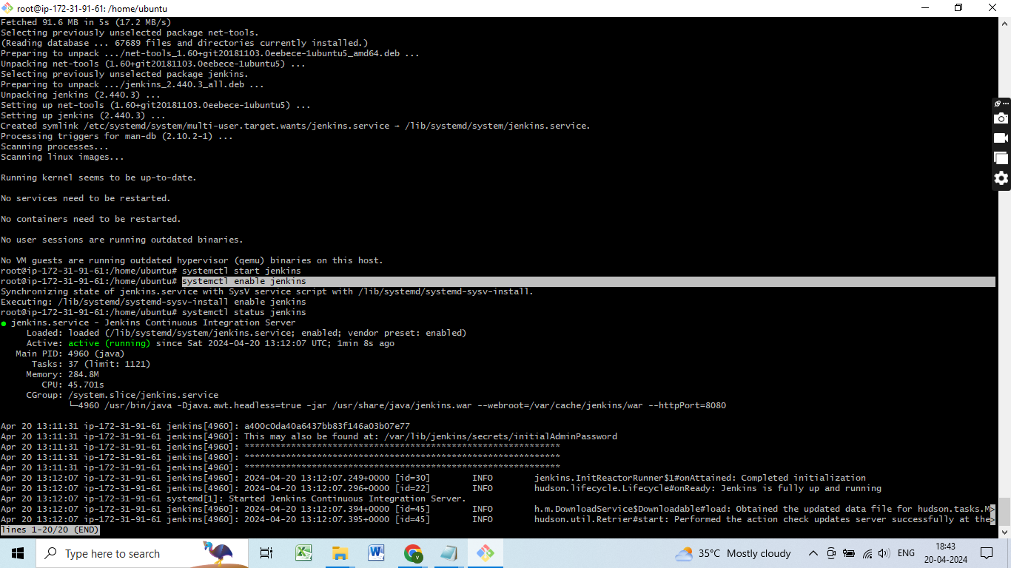
Enable Jenkins

Slide 25
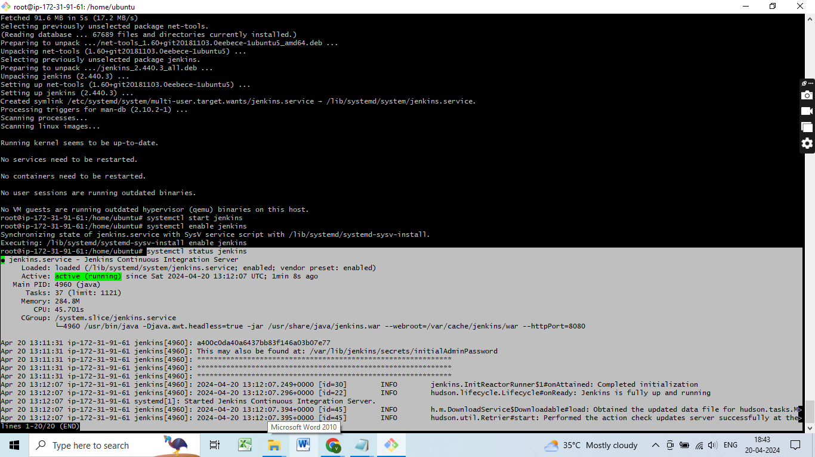
Systemctl status jenkins

Slide 26
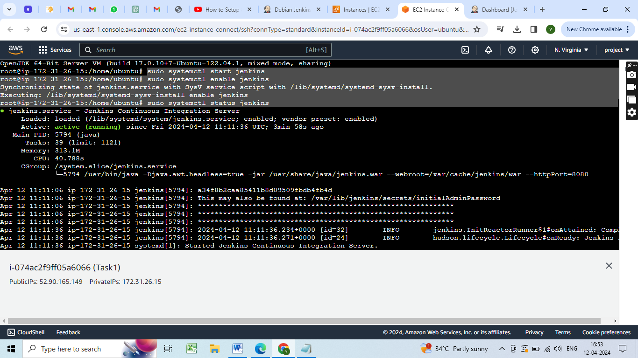
Status of Jenkins

Slide 27
3. Acess Jenkins
Open a web browser and navigate to Jenkins login page
https://ec2-public-ip:8080/

Slide 28
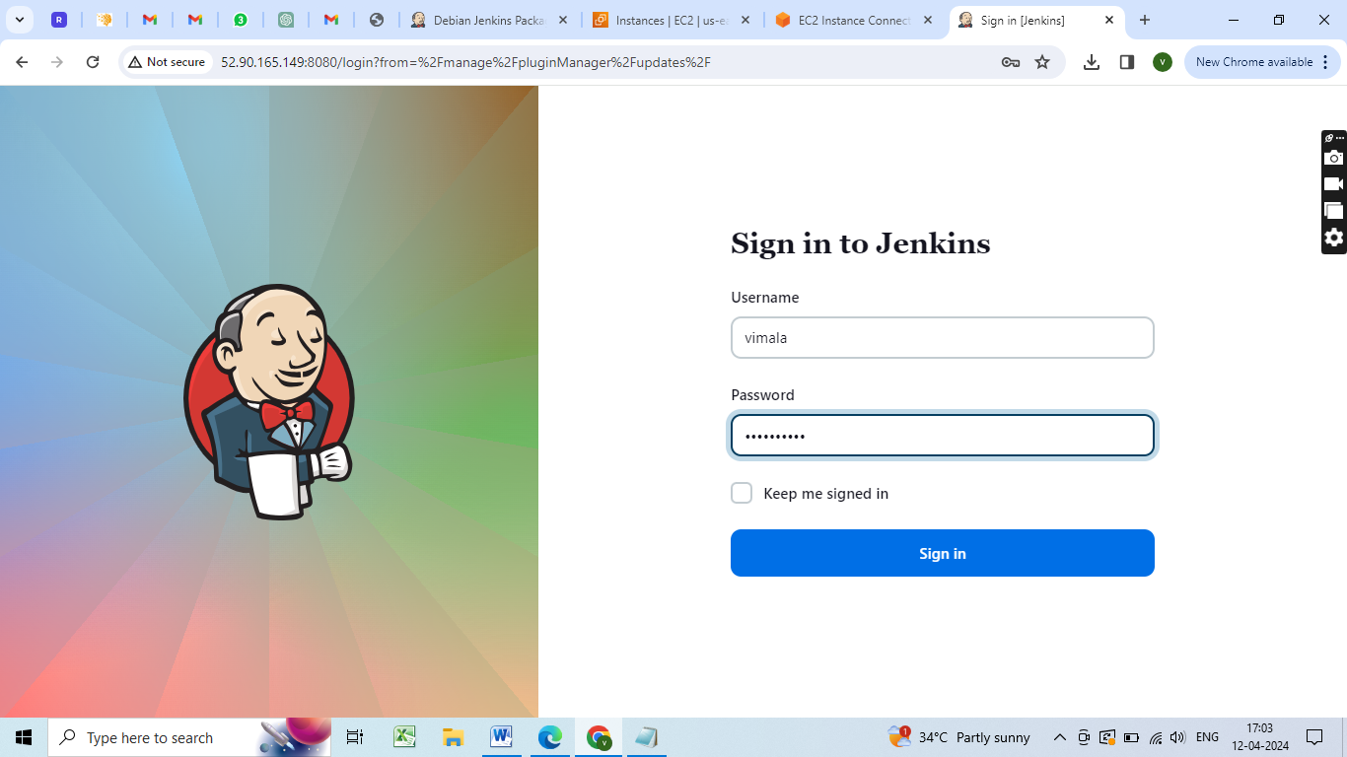
Jenkins login page

Slide 29
Retrieve the initial admin password from the Jenkins server:
sudo cat/var/lib/jenkins/secrets/initialAdminPassword

Slide 30
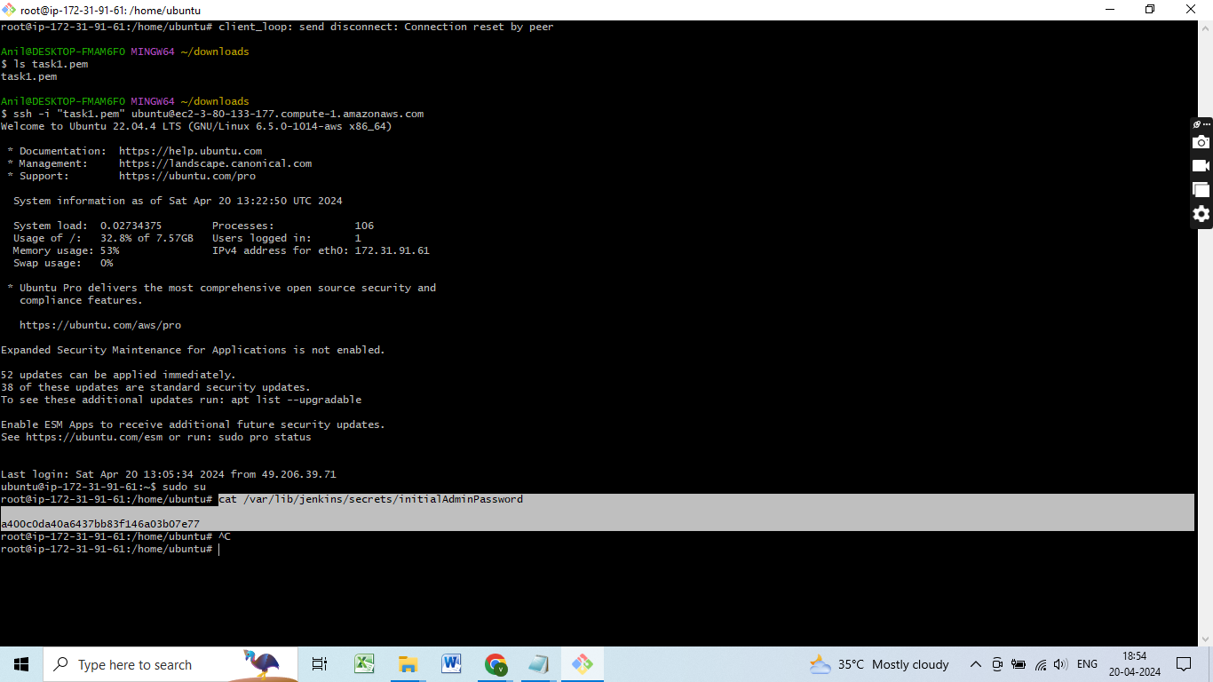
cat/var/lib/jenkins/secrets/initialAdminPassword

Slide 31
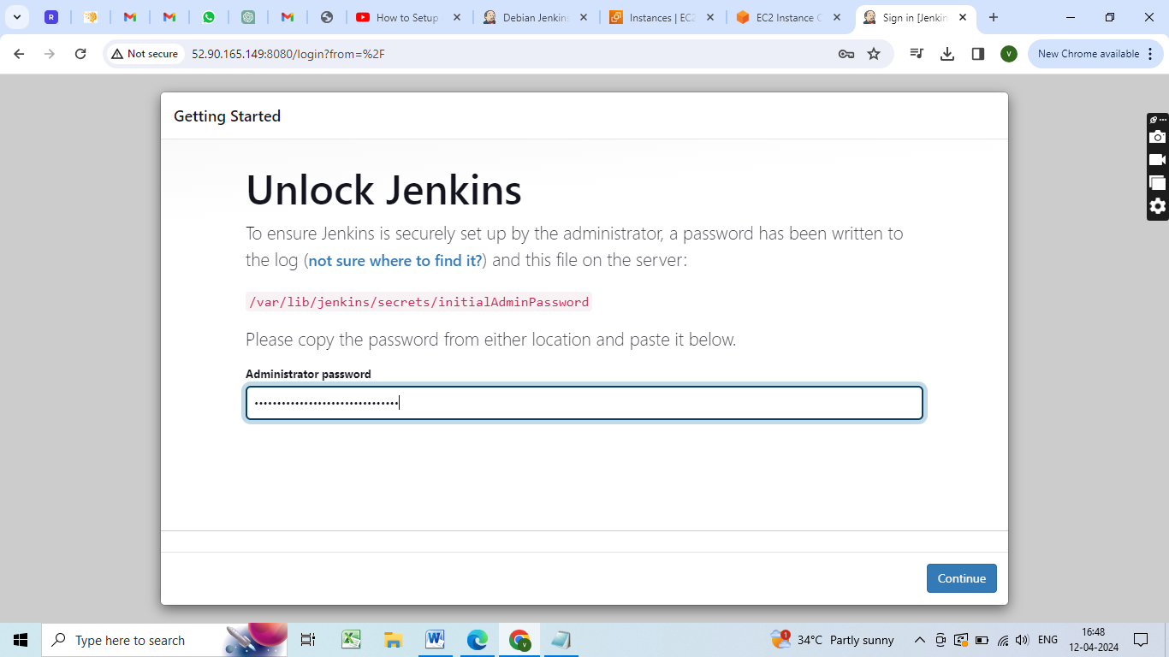
Jenkins Configuration: cat/var/lib/jenkins/secrets/initialAdminPassword

Slide 32
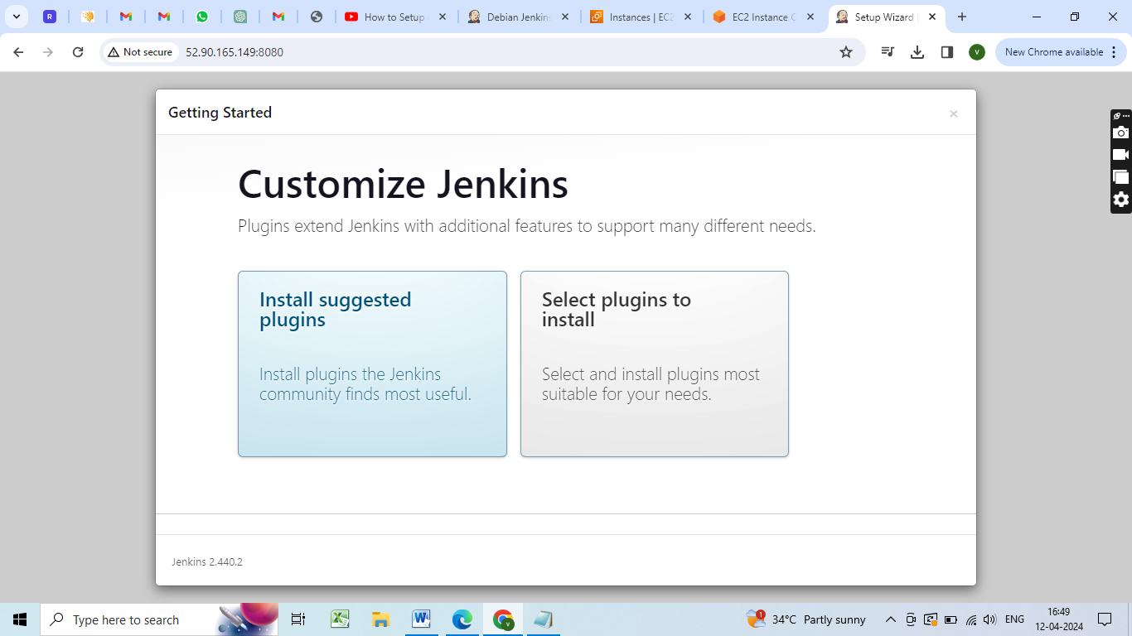
Click ‘Install suggested plugins”

Slide 33
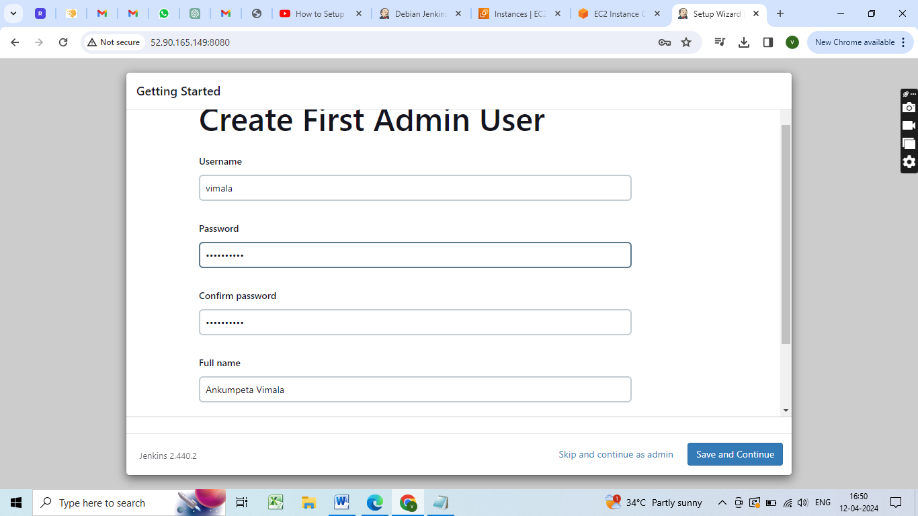
Creating admin user

Slide 34
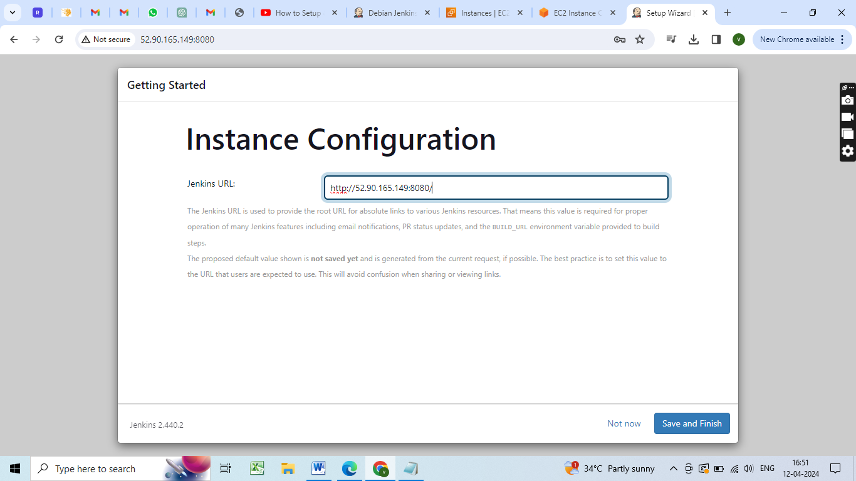
Instance configuration

Slide 35
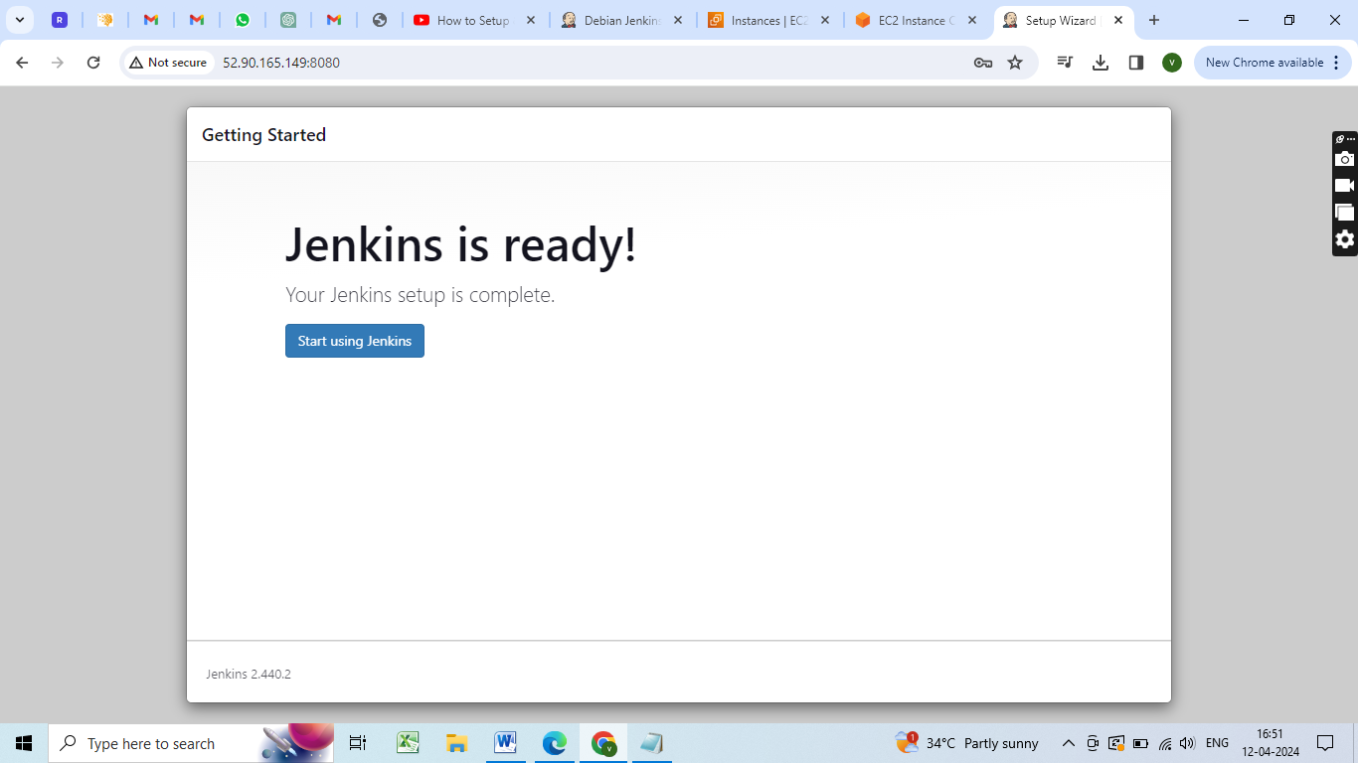
Start using Jenkins

Slide 36
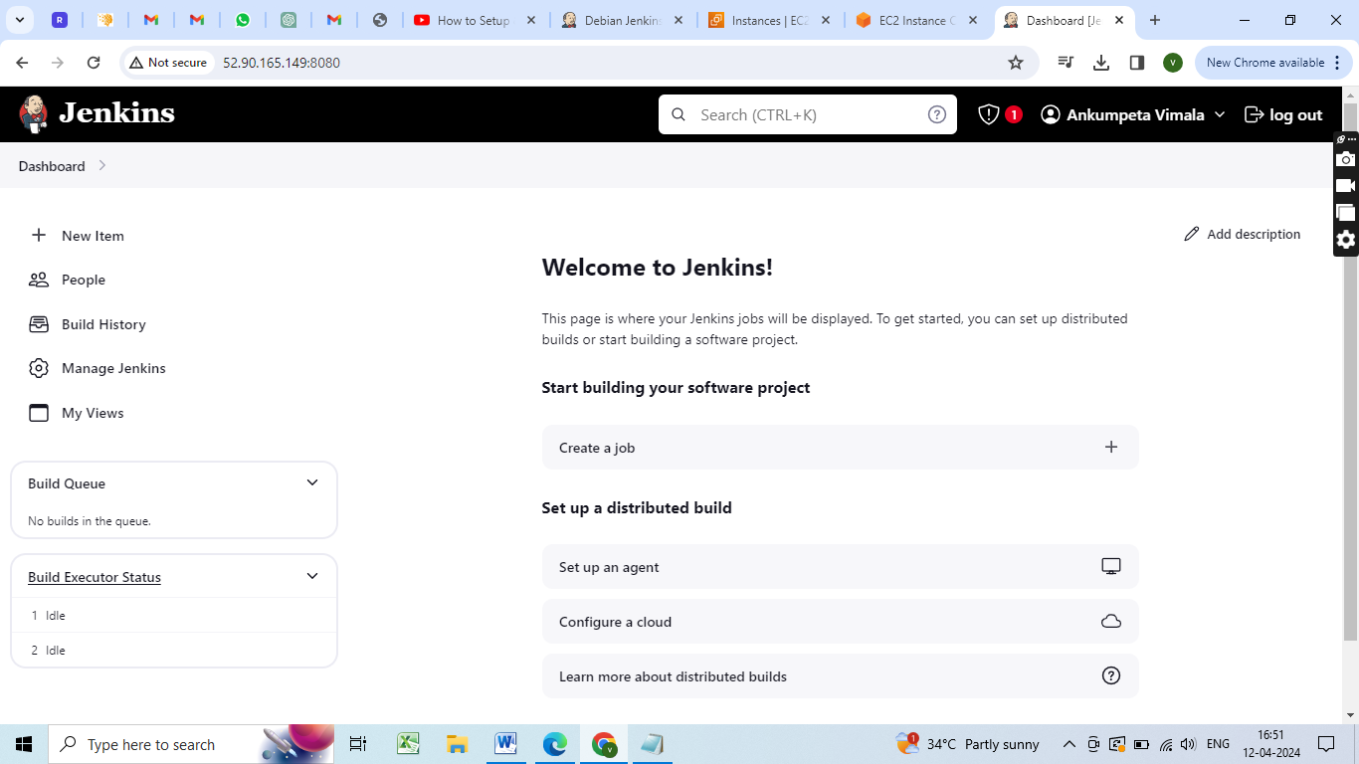
Jenkins Homepage

Slide 37
Install Required Plugins:
In Jenkins, go to "Manage Jenkins" > "Manage Plugins."
Install necessary plugins (e.g., Pipeline, GitHub, Docker).

Slide 38
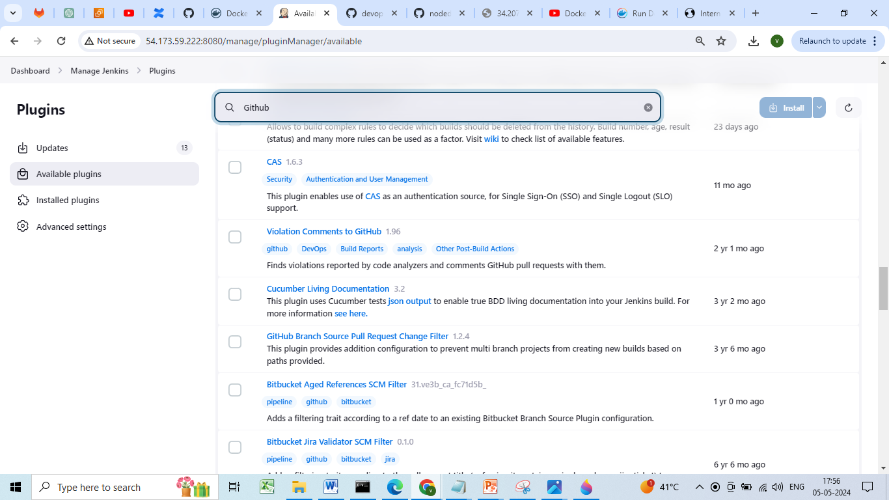
Install Plugins

Slide 39
Jenkins Pipeline
Jenkins Pipeline is a powerful feature that allows users to define their build pipelines as code using a domain-specific language (DSL).
This enables users to create complex, multi-stage pipelines that are version-controlled, maintainable, and easy to understand.

Slide 40
Create Jenkins Pipeline
Create a new Jenkins job.
Select "Pipeline" as the job type.
Write your Groovy script in the pipeline configuration

Slide 41
Jenkins Pipeline types
* Pipeline (series of tasks done in order on different servers) as code
* Groovy DSL
- scripted pipeline
Jenkins will automatically generate the pipeline.
Uses Groovy scripting language.
Provides more flexibility and control with its imperative scripting approach.
Code is written directly in Jenkinsfile using Groovy syntax.
Suitable for complex and dynamic pipeline requirements.
Requires a deeper understanding of Groovy and Jenkins internals.

Slide 42
declarative pipeline
Uses a structured, declarative syntax.
Provides a simpler, more opinionated way to define pipelines.
Follows a more standardized structure, making it easier to read and maintain.
Designed to promote best practices and enforce certain conventions.
Preferred for straightforward pipelines and for those who prefer a more structured approach.
* Jenkinsfile - Gitlab repository

Slide 43
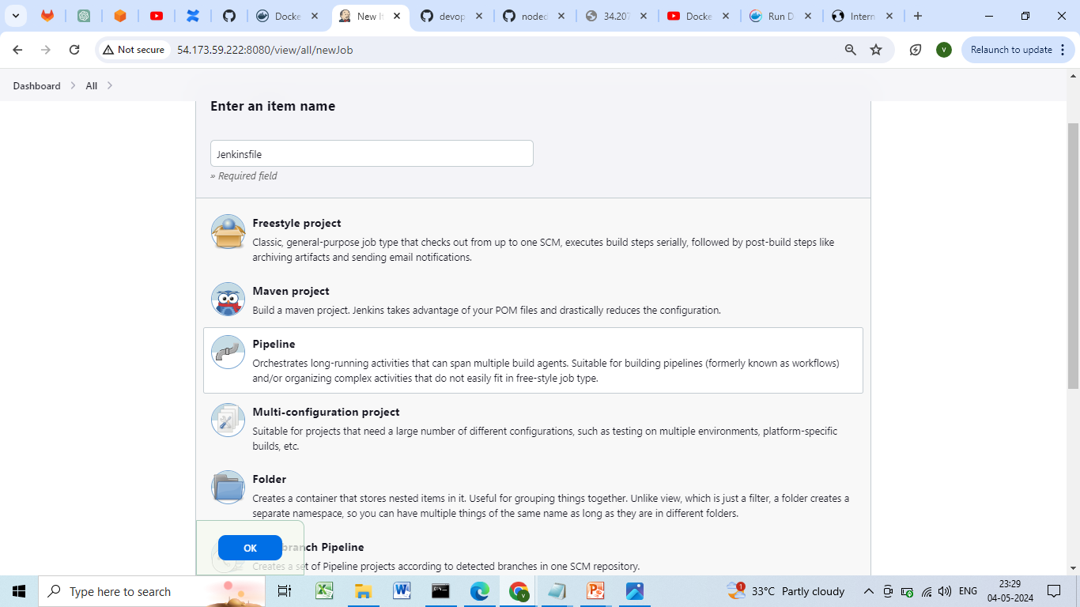
Creating a jenkins pipeline

Slide 44
4. Configure Version Control:
Set up a Git repository on GitHub or GitLab to host the web application code.
The first step in setting up a CI/CD pipeline is to store your source code in a repository.
This will allow you to manage and track changes to your code over time.

Slide 45
If you haven't already, create a repository for your web application in a Git-based repository management platform, such as GitHub or GitLab.
Make sure to push your latest code changes to the repository.
gitclone https://github.com/ankumpetvimala/TASK-INTERN-CAREER.git

Slide 46
Creating a Sample webapplication
Index.html
---------------
<!DOCTYPE html>
<html>
<body>
<h1>Intern Career</h1>
<p><a href ="https://studio.openweaver.com/apps/preview/
vimalaankumpeta/Intern%20career/home">Visit Intern Carrer!</a></p>
</body>
</html>

Slide 47
https://studio.openweaver.com/apps/preview/vimalaankumpeta/Intern%20career/home
<!doctype html>
<html lang="en">
<head>
<meta charset="utf-8"/>
<meta name="viewport" content="width=device-width,initial-scale=1"/>
<meta name="theme-color" content="#000000"/>
<meta name="description" content="Built using Open Weaver Studio"/>
<link rel="apple-touch-icon" href="/apps/images/logo.png"/>
<meta property="og:description" content="Built using Open Weaver Studio"/>

Slide 48
<meta name="image" property="og:image" content="/apps/images/logo.png"/>
<meta property="og:type" content="video.movie"/>
<meta name="twitter:image" content="/apps/images/logo.png"/>
<meta name="twitter:description" content="Built using Open Weaver Studio">
<script defer="defer" src="/apps/static/js/main.4eddc930.js">
</script>
</head>
<body>
<noscript>You need to enable JavaScript to run this app.</noscript>
<div id="root" style="height:100%">
</div>
</body>
</html>

Slide 49
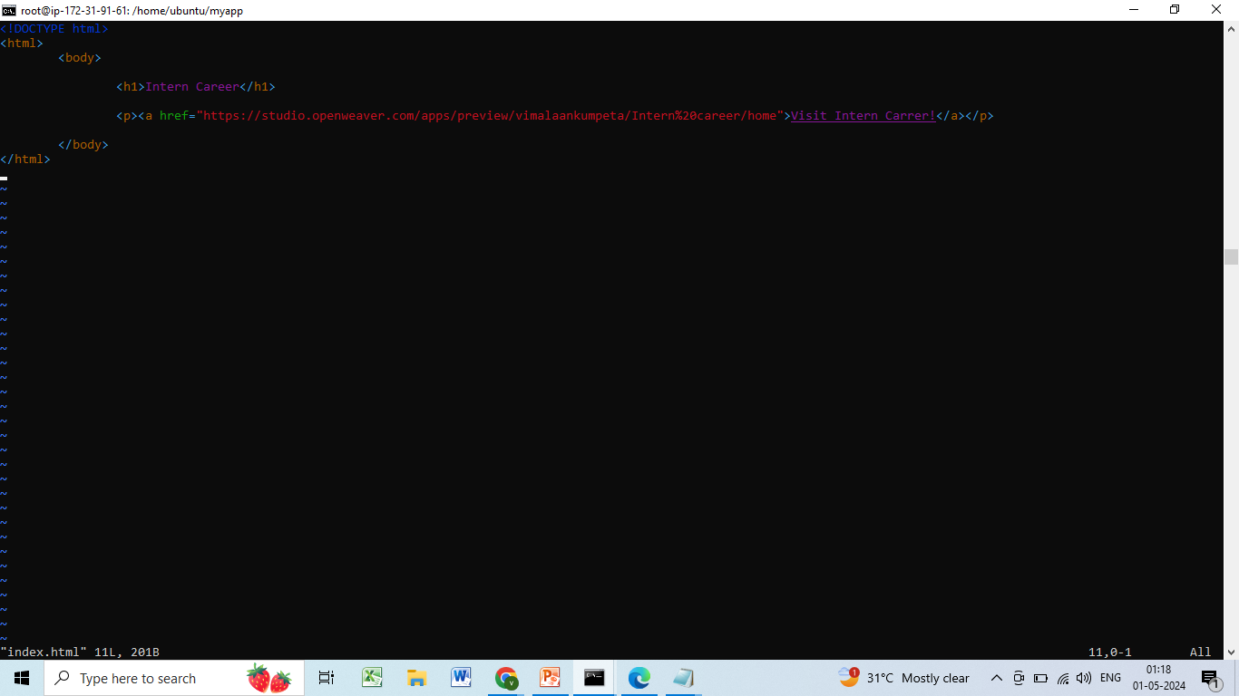
vi index.html

Slide 50
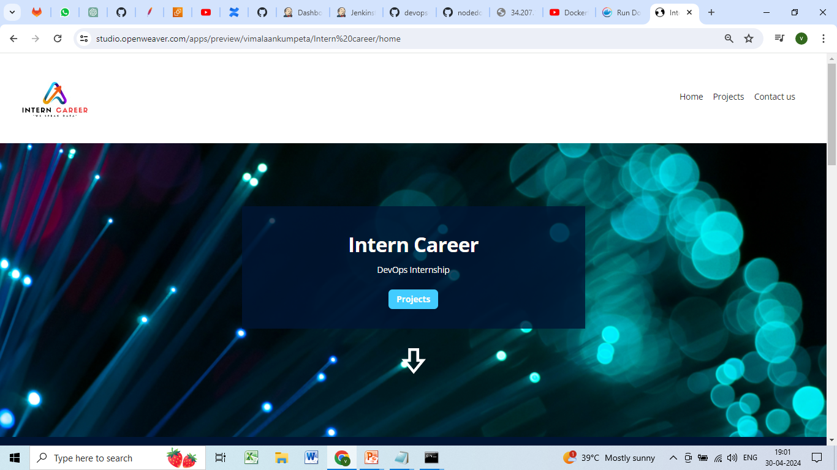
Homepage

Slide 51
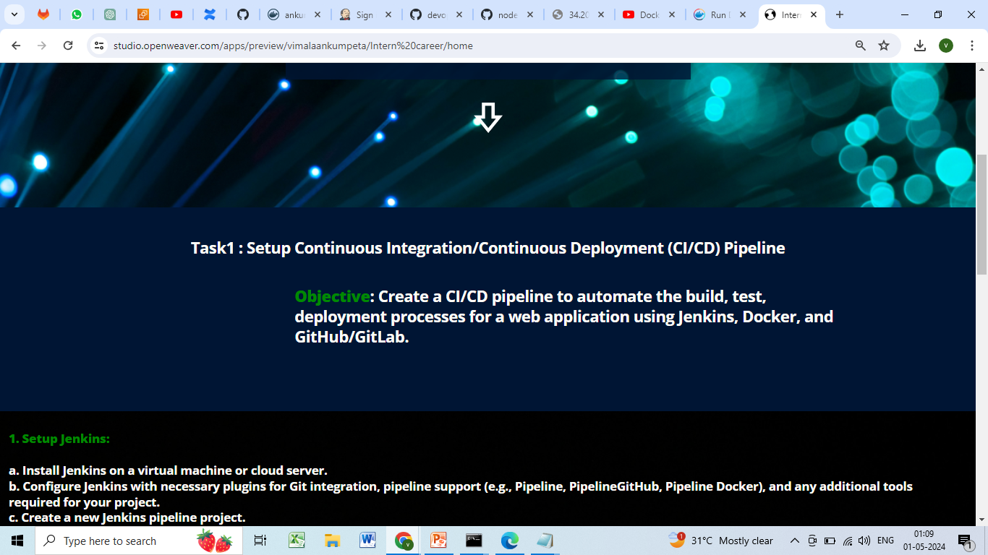

Slide 52
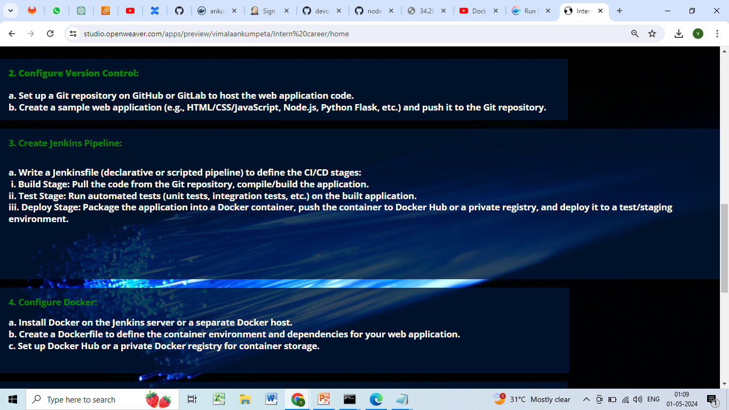

Slide 53
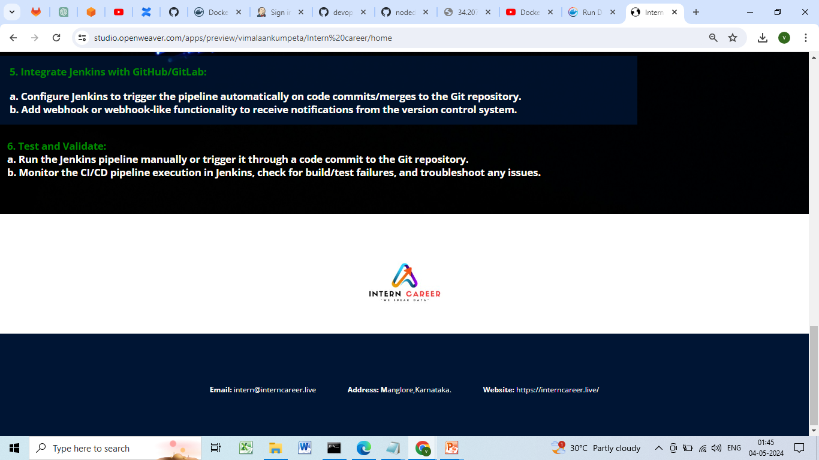

Slide 54
Click on projects

Slide 55
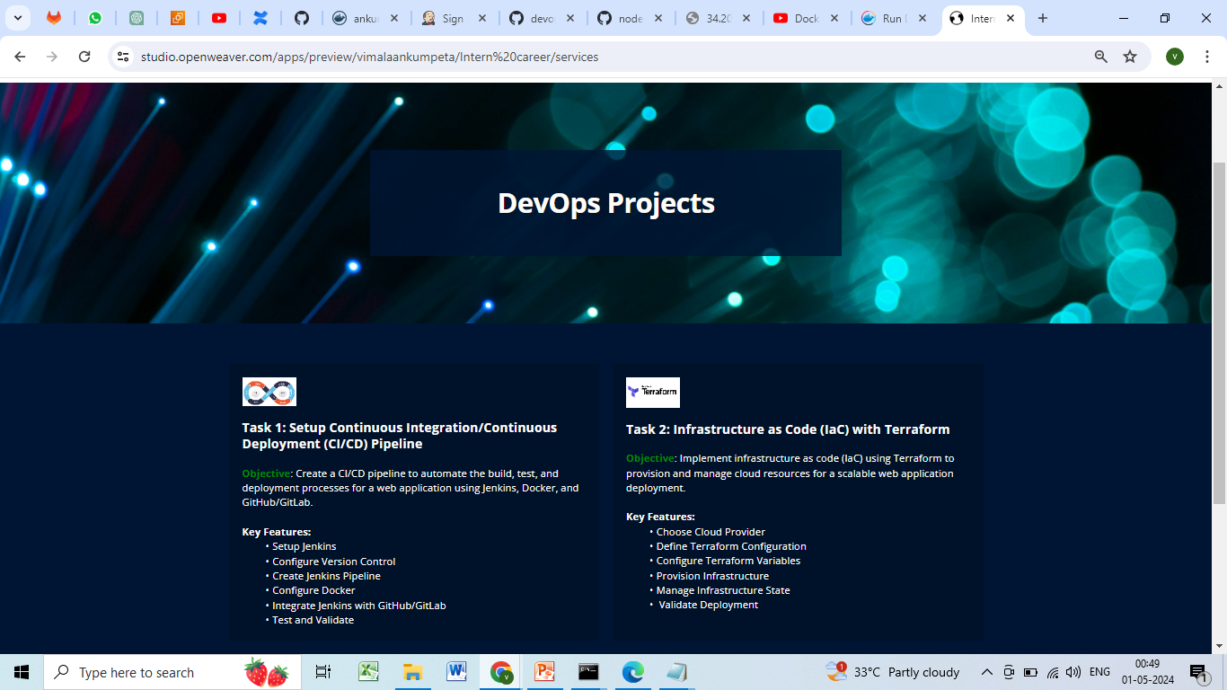
Project

Slide 56
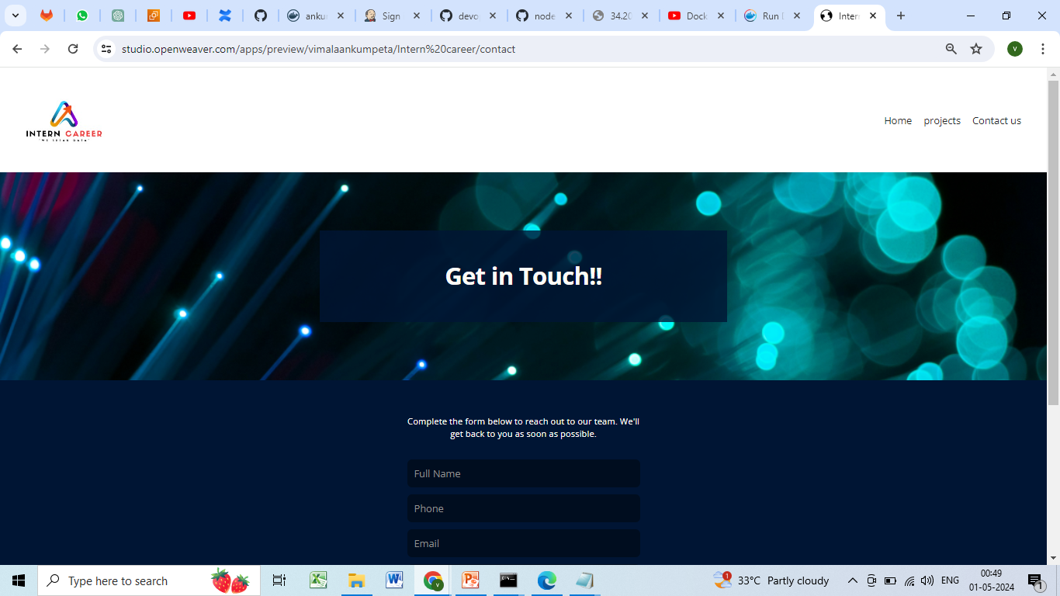
Contact us

Slide 57
creating a sample web application and pushing it to a Git repository
1. Choose a Technology Stack:
Decide on the technology stack for your web application.
For a simple example, you could use HTML/CSS/JavaScript for the frontend and Node.js for the backend.
2. Set Up Your Development Environment:
Install Node.js and npm (Node Package Manager) on your machine if you haven't already.

Slide 58
3 Create Your Web Application:
Create a new directory for your project and navigate into it.
Create HTML, for your frontend in the project directory.
Create a Node.js file for your backend logic (e.g., server.js) in the same directory.
Initialize a Git Repository:
Run git init in the project directory to initialize a new Git repository.
4 Add Your Files to the Repository:
Use git add . to stage all files in the directory for committing.

Slide 59
5 Commit Your Changes:
Commit your changes with a descriptive message using git commit -m "Initial commit".
6 Create a Remote Repository:
Go to GitHub or GitLab and create a new repository for your project.
7 Link Your Local Repository to the Remote Repository:
Use git remote add origin <remote repository URL> to add the remote repository as the origin.

Slide 60
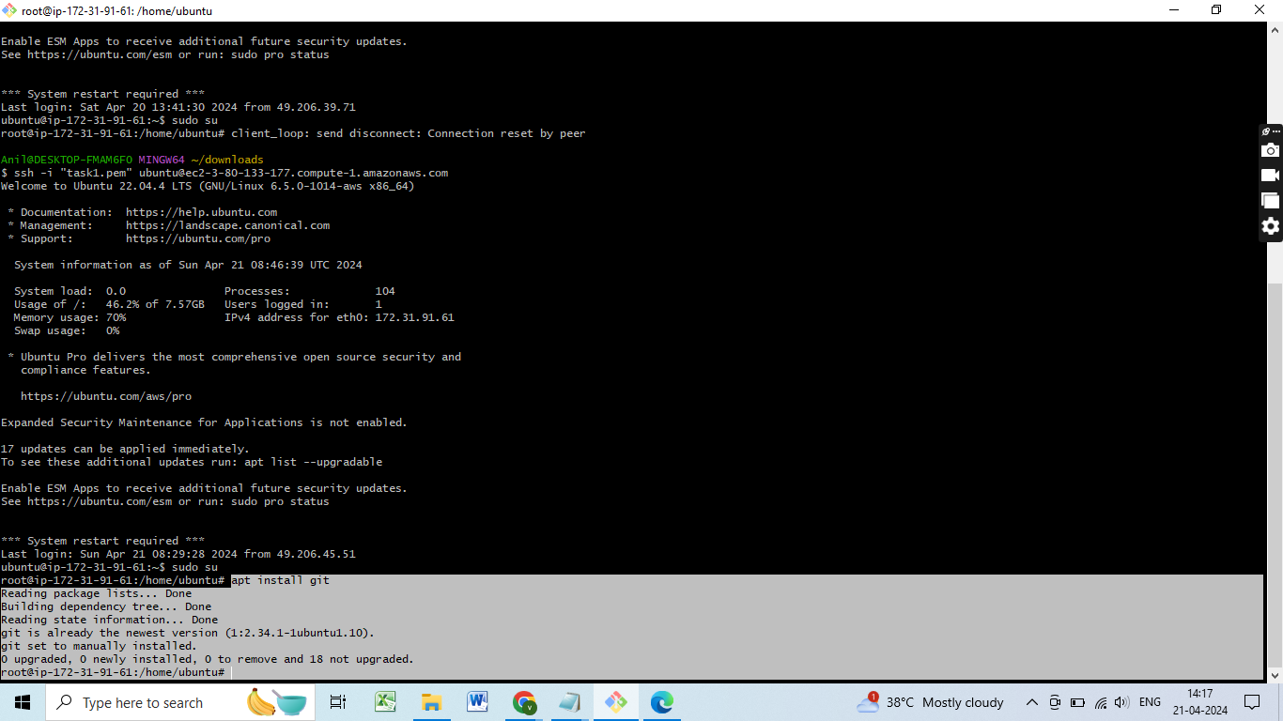
Installing Git

Slide 61
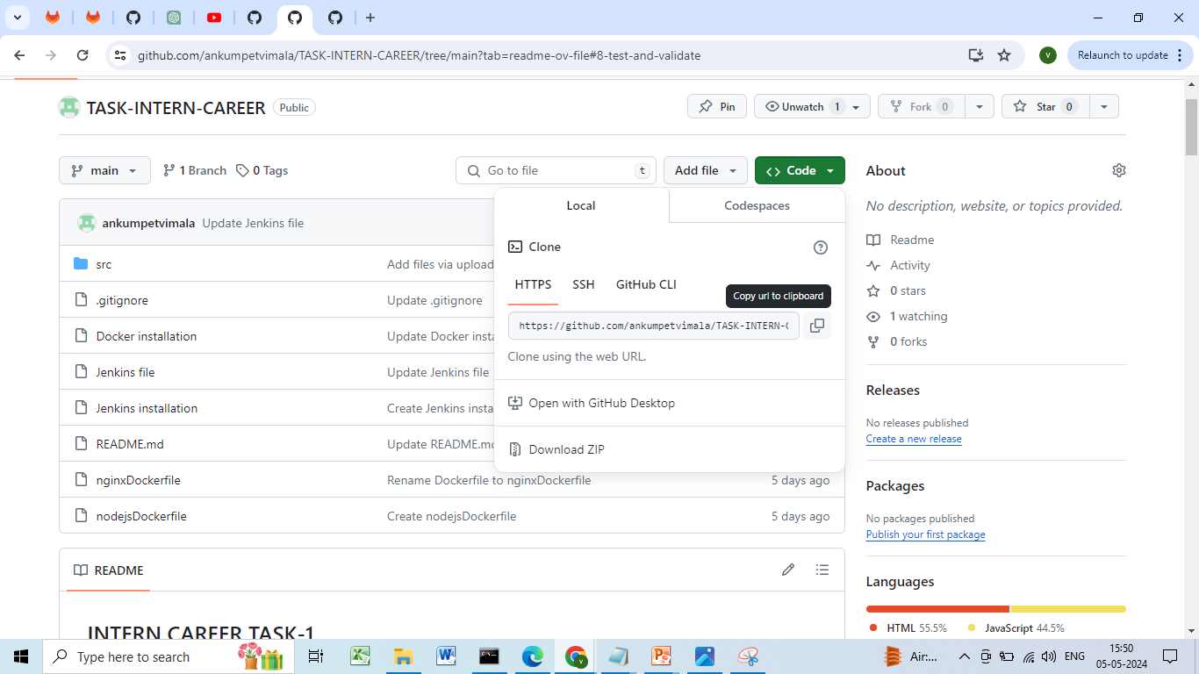
Git clone

Slide 62
8 Push Your Changes to the Remote Repository:
Push your committed changes to the remote repository with git push -u origin master.
9 Verify Your Changes:
Visit your remote repository on the Git hosting service to verify that your files have been pushed successfully.

Slide 63
5. Create Jenkins Pipeline:
Write a Jenkinsfile (declarative or scripted pipeline) to define the CI/CD stages:
i. Build Stage: Pull the code from the Git repository, compile/build the application.
ii. Test Stage: Run automated tests (unit tests, integration tests, etc.) on the built application.
iii. Deploy Stage: Package the application into a Docker container, push the container to Docker

Slide 64
Jenkins file
pipeline {
agent any
stages {
stage('git clone') {
steps {
// Clone the Git repository
git branch: 'main', credentialsId: 'github',
url: 'https://github.com/ankumpetvimala/TASK-INTERN-CAREER.git'
}
}
stage('Build') {
steps {
// Build the Docker image
'docker build -t myapp .'
}
}

Slide 65
stage('Test') {
steps {
// Run automated tests
'docker run myapp npm test'
}
}
stage('Deploy') {
steps {
// Push the Docker image to the registry
'docker push myapp:latest'
}
}
}
}

Slide 66
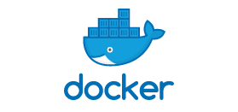
6. Configure Docker:
Docker :-
Docker is a tool designed to make it easier to create, deploy, and run applications by using containers. Containers allow a developer to package up an application with all of the parts it needs, such as libraries and other dependencies, and ship it all out as one package. By doing so, thanks to the container, the developer can rest assured that the application will run on any other Linux machine regardless of any customized settings that machine might have that could differ from the machine used for writing and testing the code. In a way, Docker is a bit like a virtual machine

Slide 67
But unlike a virtual machine, rather than creating a whole virtual operating system.
Docker allows applications to use the same Linux kernel as the system that they're running on and only requires applications be shipped with things not already running on the host computer.
This gives a significant performance boost and reduces the size of the application.
And importantly, Docker is open source.
This means that anyone can contribute to Docker and extend it to meet their own needs if they need additional features that aren't available out of the box.

Slide 68
DOCKER INSTALLATION
$ sudo apt update –y
$ sudo apt install apt-transport-https ca-certificates curl software-properties-common –y
$ curl -fsSL https://download.docker.com/linux/ubuntu/gpg | sudo apt-key add –
$ sudo add-apt-repository "deb [arch=amd64] https://download.docker.com/linux/ubuntu bionic stable" -y
$ apt-cache policy docker-ce -y

Slide 69
$ sudo apt install docker-ce -y
$ sudo systemctl status docker | systemctl start docker
$ sudo chmod 777 /var/run/docker.sock
$ which docker
$ docker info

Slide 70
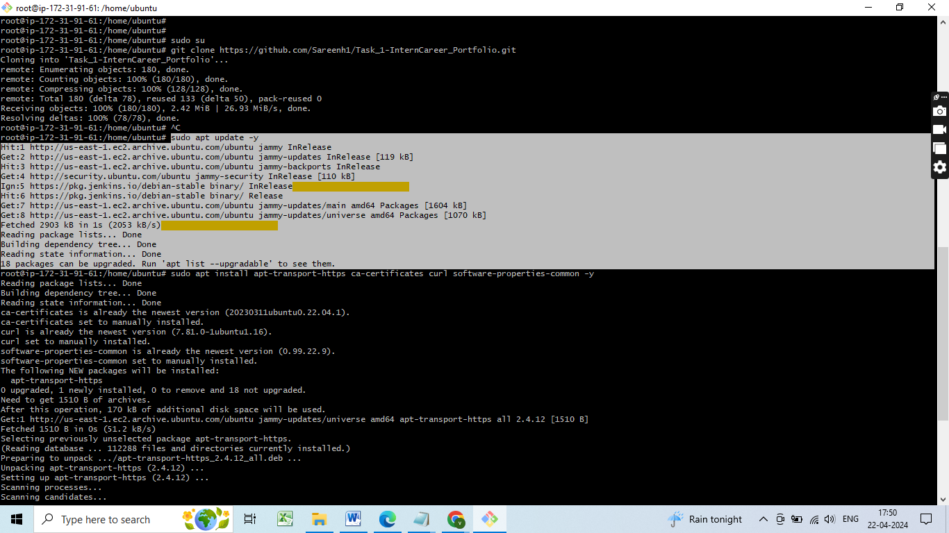
Sudo apt update -y

Slide 71
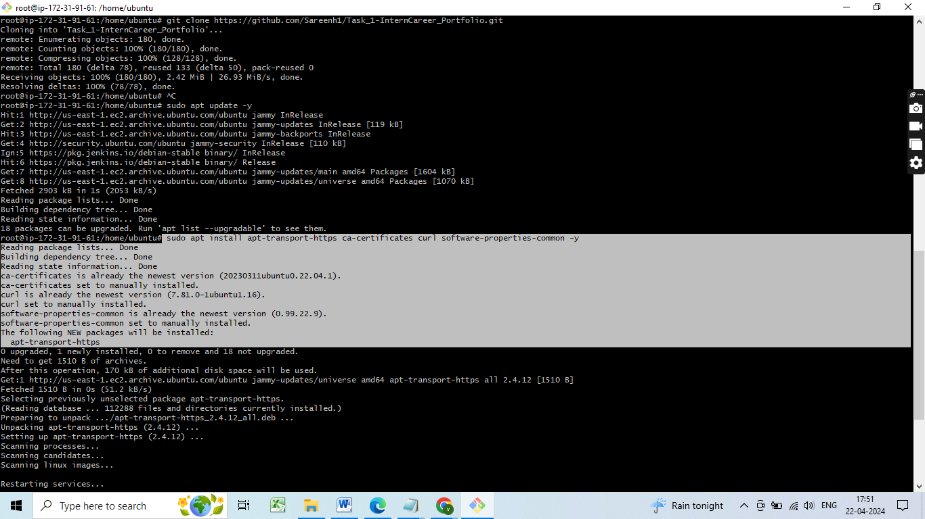
apt install apt-transport-https ca-certificates curl software-properties-common -y

Slide 72
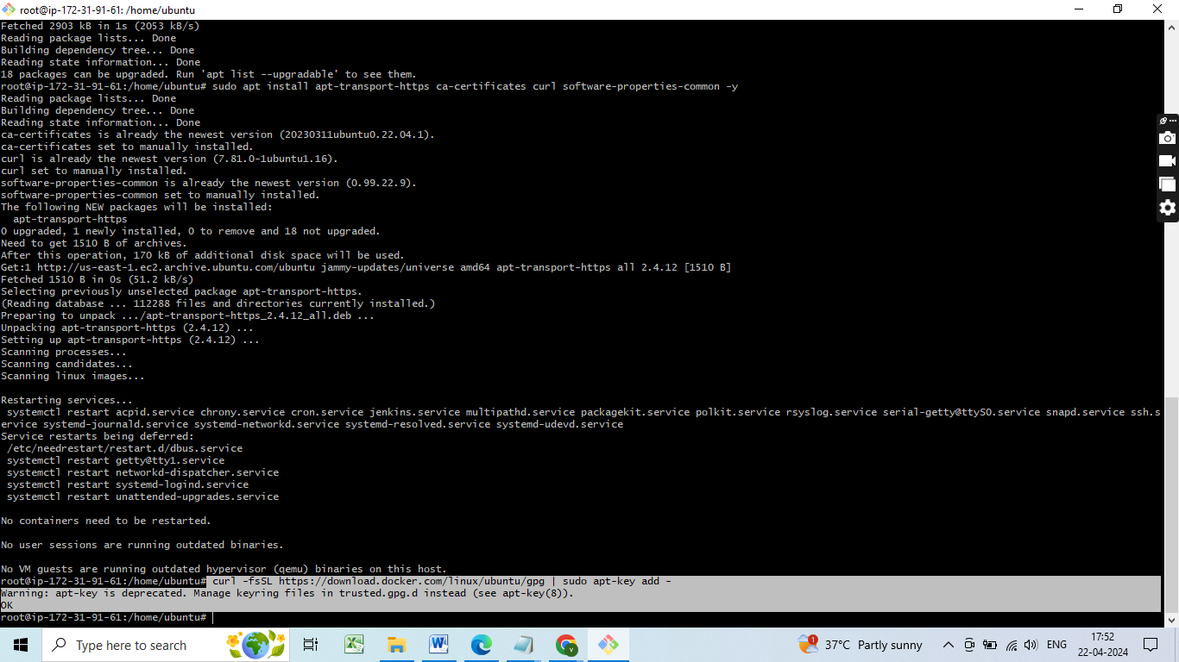
curl -fsSL https://download.docker.com/linux/ubuntu/gpg | sudo apt-key add -

Slide 73
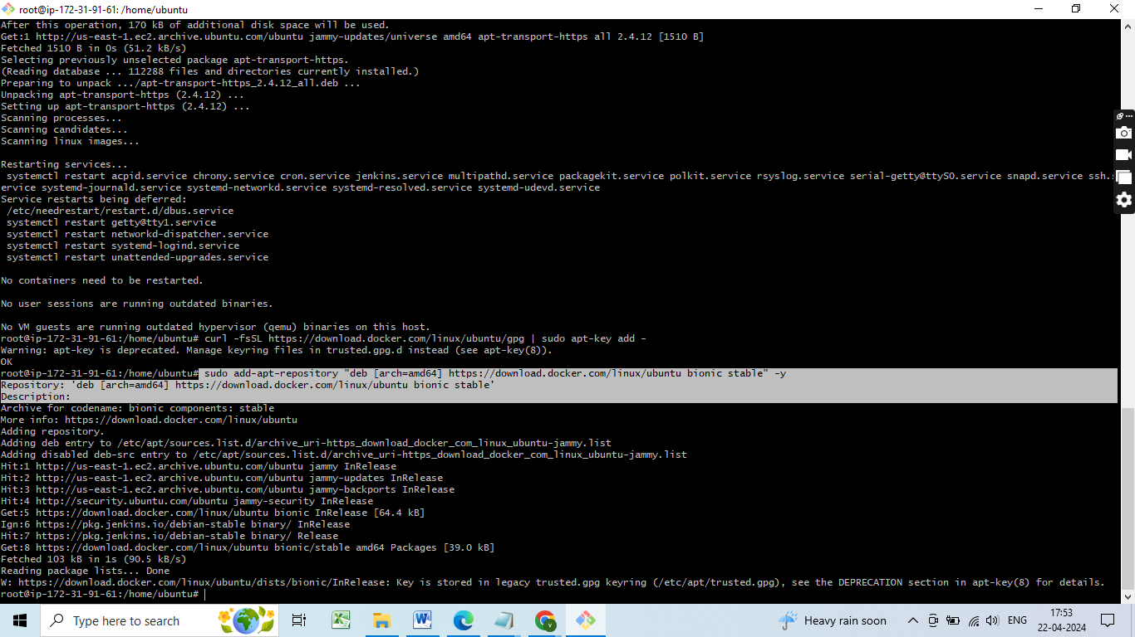
sudo add-apt-repository "deb [arch=amd64] https://download.docker.com/linux/ubuntu bionic stable" -y

Slide 74
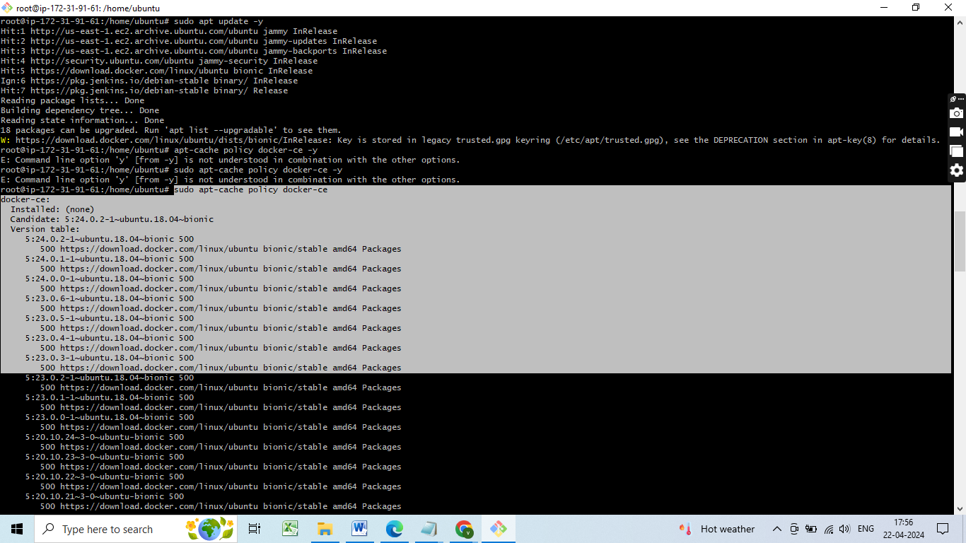
sudo apt-cache policy docker-ce -y

Slide 75
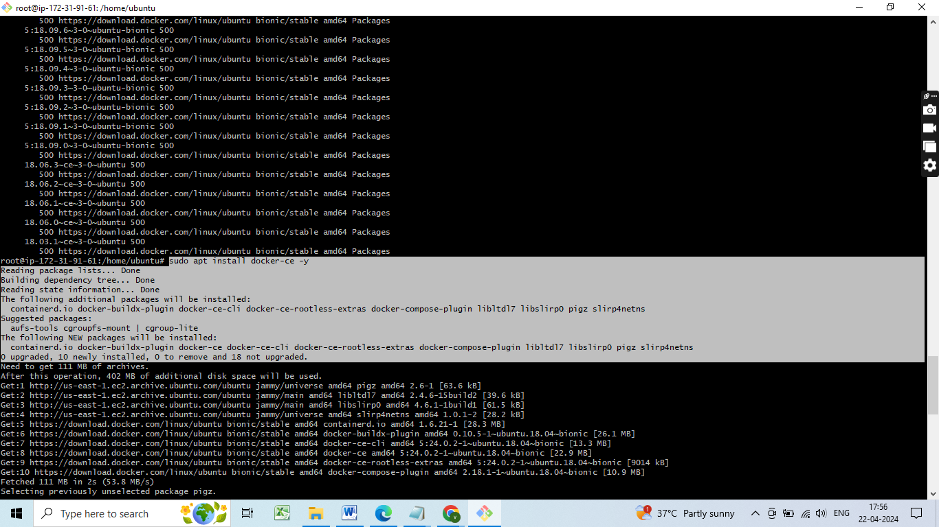
sudo apt install docker-ce -y

Slide 76
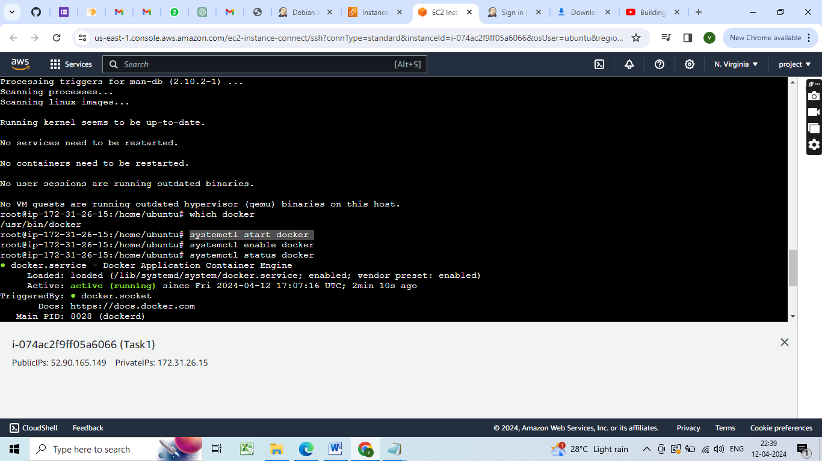
Docker status

Slide 77
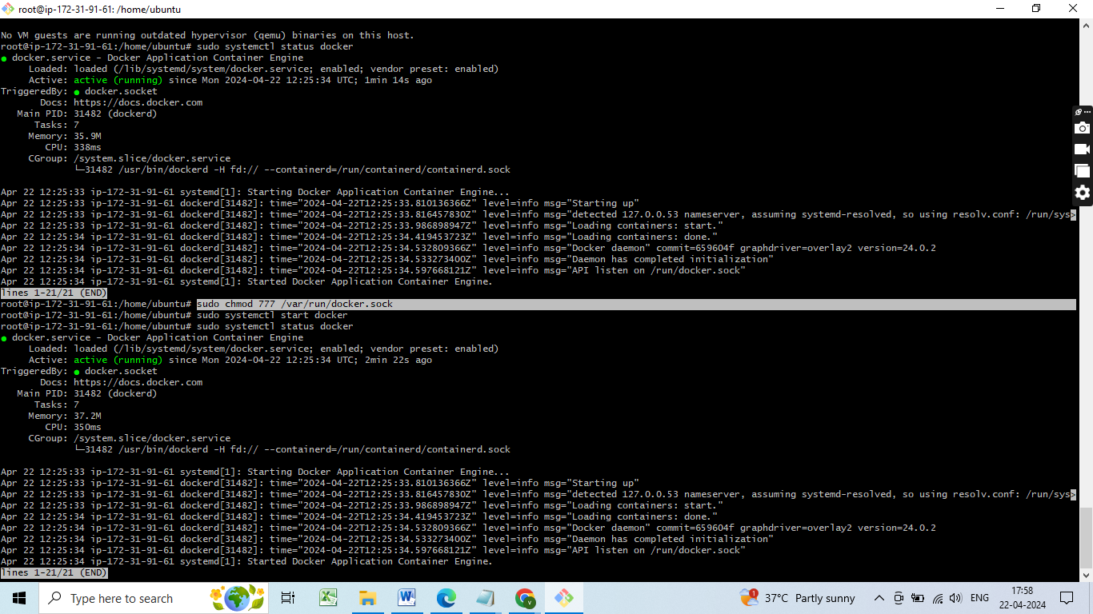
sudo chmod 777 /var/run/docker.sock

Slide 78
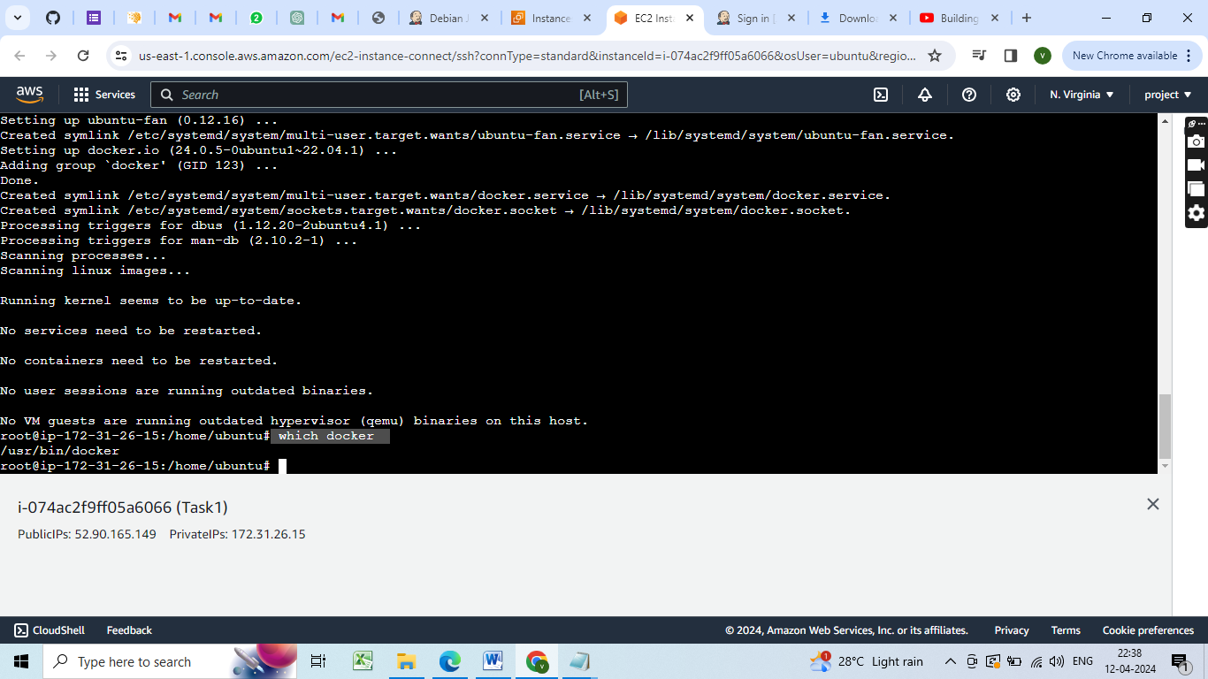
which docker

Slide 79
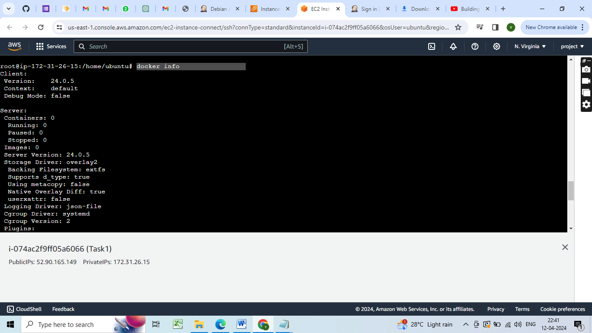
docker info

Slide 80
Creating a Docker file
Step 1 - Create a new directory
mkdir myapp
cd myapp
Step 2 - Create a file called "index.html”
Step 3 - Create a file named Dockerfile
touch Dockerfile

Slide 81
Step 4 - Open the "Dockerfile" file in a text editor and add the following lines:
FROM nginx
COPY index.html /usr/share/nginx/html
This Dockerfile defines a new Docker image that
- uses the official nginx image as a base
- then copy the index.html file to the appropriate location in the image
A Dockerfile is a text file with instructions to build a Docker Image
When we run a Dockerfile, Docker image is created
When we run the docker image, containers are created

Slide 82
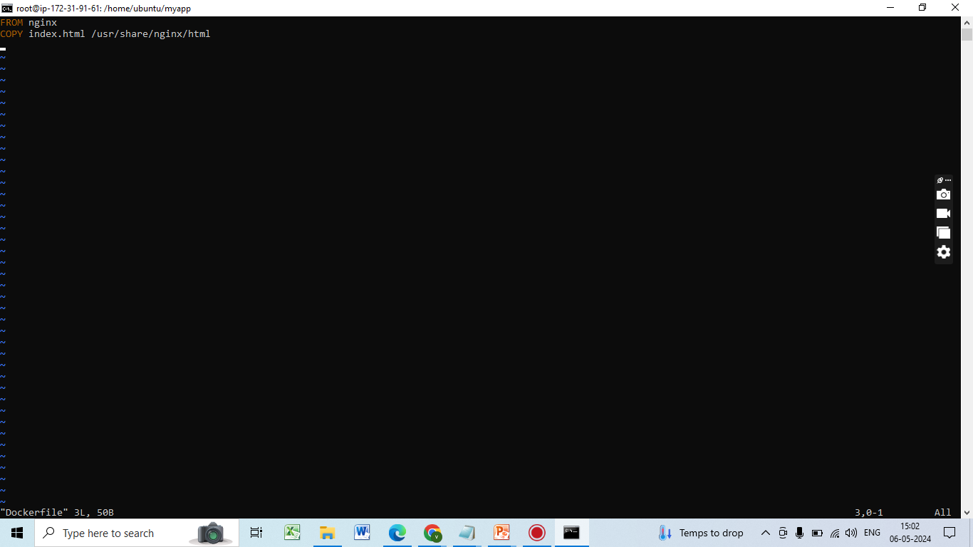
Dockerfile

Slide 83
Step 5 - Start docker & Build docker image from dockerfile
docker build -t myapp .
This command builds a new Docker image with the tag "myapp" using the Dockerfile in the current directory.
Step 6 - Run docker container from the image
docker run -p 8090:80 myapp
This tells Docker to run the myapp container and map port 8090 on your local machine to port 80 inside the container

Slide 84
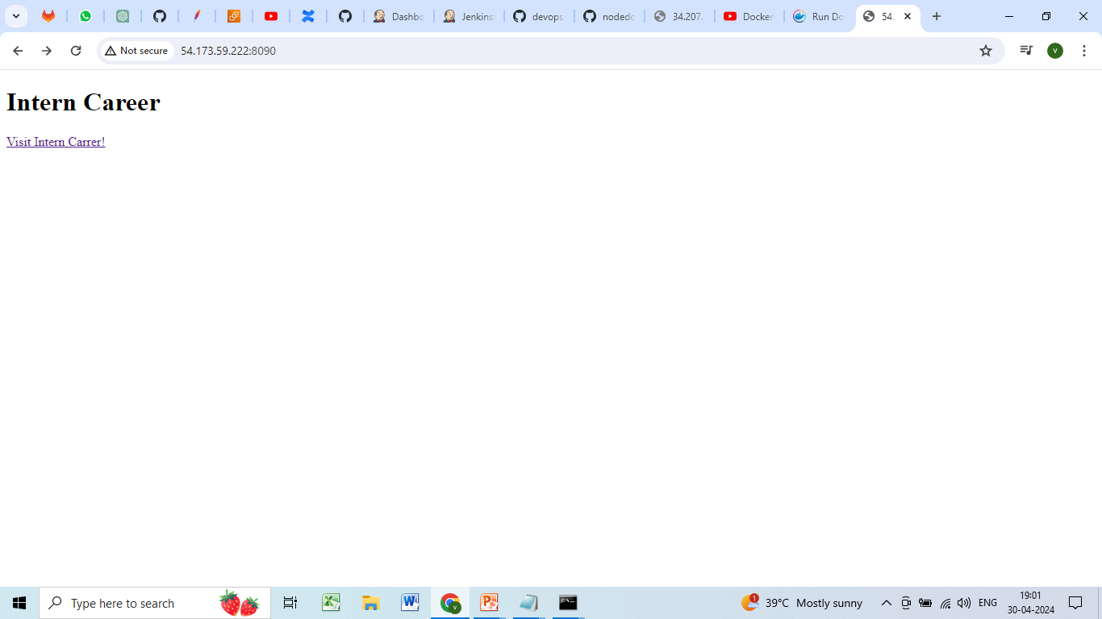
Access the app
Open a web browser and navigate to http://localhost:8090 to see the “index.html file" displayed in your web browser.

Slide 87
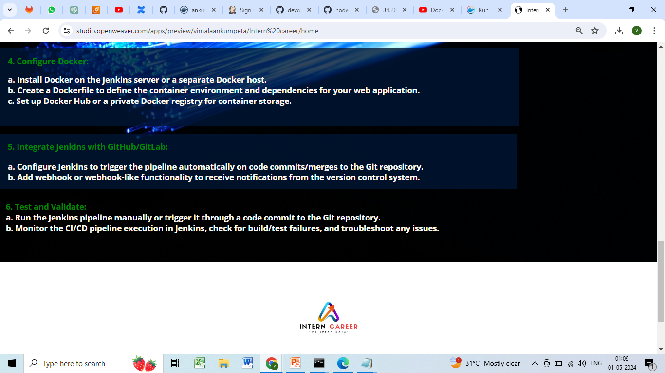

Slide 88


Slide 89
7. Integrate Jenkins with GitHub/GitLab:
GitHub Integration:
Go to your GitHub repository.
Under "Settings," select "Developer settings."
Generate a classic token and copy it.

Slide 90

GitHub Integration:

Slide 91

Github token

Slide 92
Configure Jenkins with GitHub Credentials:
In Jenkins, go to "Manage Jenkins" > "Configure System."
Add your GitHub username and paste the Github token as the password.

Slide 93

Configure Jenkins with GitHub Credentials:

Slide 94


Slide 95

Github username
Github token

Slide 96
DockerHub Integration:
**Dockerhub Integration**
Go to DockerHub.
click on security.
Generate an access token.

Slide 97

Dockerhub Integration

Slide 98
Configure DockerHub in Jenkins:
In Jenkins, go to "Manage Jenkins" > "Configure System."
Add your DockerHub username and paste the token.

Slide 99

Configure DockerHub in Jenkins
Dockerhub username
Dockerhub token

Slide 100
Adding Webhook in Github
Go to your GitHub repository.
Under "Settings," select "Webhooks."
Click on "Add webhook."
Set the payload URL to your Jenkins server's URL followed by /github-webhook/.
Select the events you want to trigger the webhook (e.g., Push events).
Optionally, you can set up a secret and configure Jenkins to validate the webhook payload using this secret.
Save your webhook configuration.

Slide 101

Adding webhook

Slide 102

8. Test and Validate:
Running the jenkins pipeline

Slide 103

Jenkinspipeline Build

Slide 104
Conclusion
With a CI/CD pipeline in place, you can ensure that changes to your web application are integrated and deployed quickly and with high quality. By automating the build, test, and deployment process, you can reduce the risk of bugs and downtime and improve the overall stability of your application.

Slide 105
Resources and References:
Jenkins Tutorials and Documentation:
Jenkins Documentation
Docker Guides and Resources:
Docker Documentation
GitHub/GitLab Guides:
GitHub Guides
GitLab Documentation
CI/CD Pipeline Examples:
Sample Jenkins Pipelines – GitHub
CI/CD Pipeline with Jenkins, Docker, and GitHub - Medium Article

Slide 106

Ankumpeta Vimala
vimalaankumpeta@gmail.com
https://www.linkedin.com/in/vimala-ankumpeta-442996245/

